Slide 1
Wiener Memorandum
Expert meeting in Györ
6.-8.November 2023
PRO-GE
Martina Schneller

Slide 2
Political Situation in Austria
Centre-right coalition government since 2019
  (Conservative ÖVP as senior and Green Party as junior partner)
Next parliamentary elections in 2024
Anti-workers´governmental measures:
  Government does not set effective inflation dampening measures (market intervention; higher ecxess taxation) nor to combat poverty
  Redistribution of wealth for entrepreneuers (low taxation on property; corporate taxation; ecxess subsidies during pandemic)
  Anti-workers´ legislation (under previous government introduction of 12 hours´ dail working time; cuts and measures in pension system that hit workers as gradual abolition of progressive early retirement)

Slide 3
Political situation
Far-right Freedom Party (FPÖ) on the rise

Slide 4
Key economic data
 | 2020 | 2021 | 2022 | 2023 | 2024
GDP growth (real) | - 6,5 % | + 4,6 % | + 4,7 % | - 0,8% | + 1, 2 %
Inflation | 1,4 % | 2,8 % | 8,5 % | +7,7 % | + 4,0%
Unemployment (national definition) | 9,9 % | 8,0 % | 6,3 % | 6,5 % | 6,6 %
Exports of goods | - 7,3 % | + 12,9 % | 6,0 % | 1,6 % | + 2,6%
Production (Industry) | - 5,8 % | + 9,5 % | + 4,4 % | - 2,4% | + 0,1 %
Productivity per hour (Industry) | + 0,5 % | + 4,2 % | + 0,8 % | - 2,7 % | + 0,1 %

Slide 5
Economic situation
Mild recession, but industry still in good situation
  • GDP growth is expected to be -0.8% for 2023 and +1.2% for 2024.
  • High inflation: +8.6% in 2022,
  forecast of an inflation rate of +7.7% is expected in 2023 and +4.0% in 2024.
  • On the labor market, despite increasing employment, a slight increase in the unemployment rate is expected from 6.5% in 2023 to 6.6% for 2024.
  • Austria has been in a mild recession since mid-2022, which should reverse in 2024
  High time to sustain economy by stimulating consumption and demand by raising wages

Slide 6
Production´s performance

Slide 7
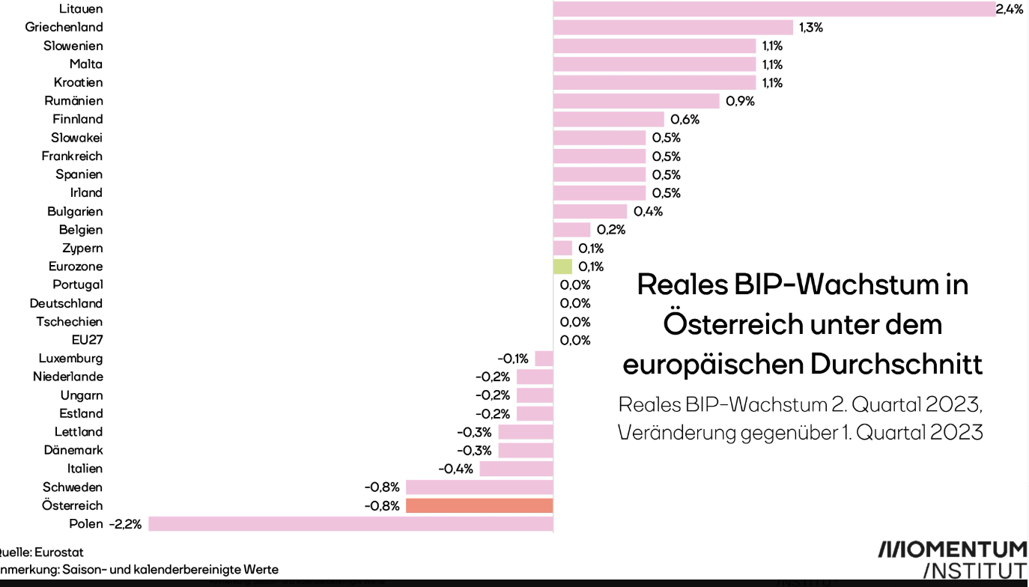
GDP Growth and inflation rates
-Real GDPgrowth in Austria under EU-average in 2. Quarter 2023

Slide 8
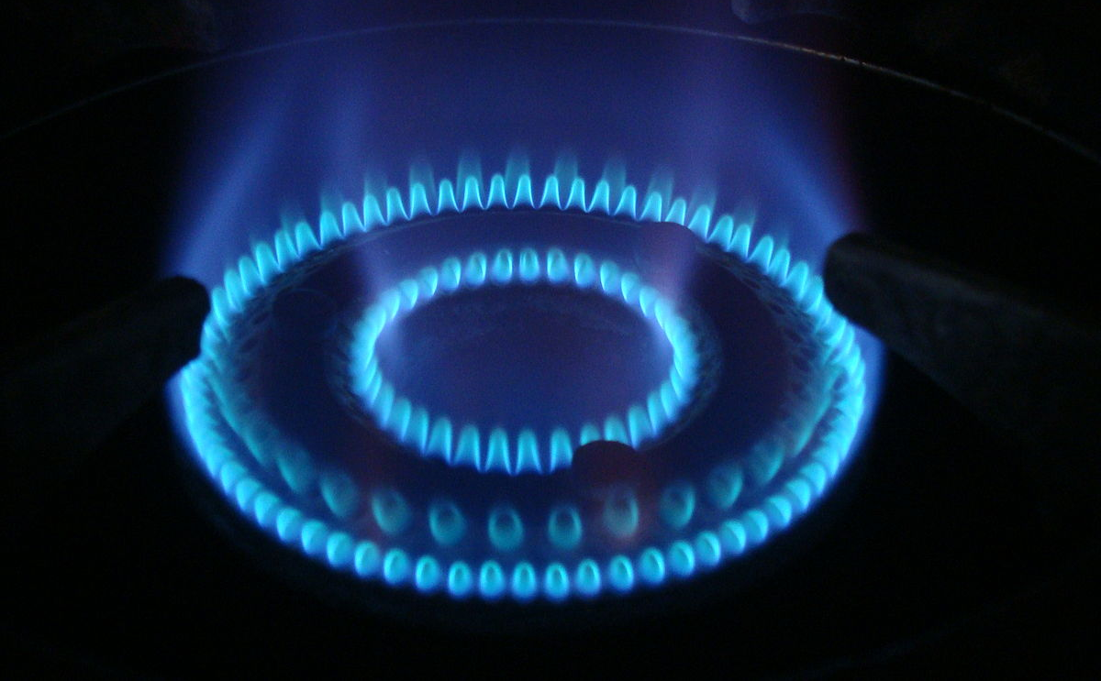
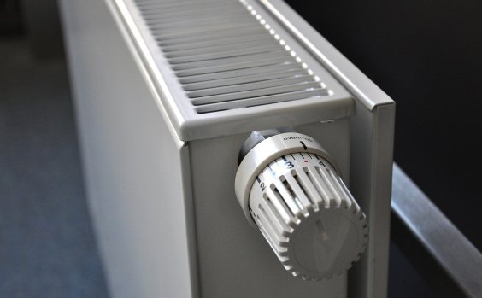
Inflation
 | Aug. 2022 - Aug. 2023
Housing, Water, Commodity | + 10,1%
Energy prices (households) | + 14,4%
Restaurants, Hotels | + 12,0%
Food | + 9,8%
The average inflation of the last 12 months is 9,6%.
Record-high price hikes in energy prices (for households) drive inflation
Gas +78,7%
"Dieses Foto" von Unbekannter Autor ist lizenziert gemäß CC BY-SA

Slide 9
Productivity and Labour unit costs

Slide 10
Collective bargaining round in metal industry
  The PRO-GE and GPA unions kicked off the autumn wage round on Monday, 25 September 25th by handing over their demands to the employers' associations in all six subsectors of the Austrian metal sector for 200.000 workers and employees.
  Demand for a pay rise of 11,6 percent
  The core demand of this year´s autumn bargaining round is an increase of minimum wages/ salaries as well as actually paid out wages/salaries of 11,6 percent.
  As the negotiations of the metal industry set the pace for the subsequent negotiations in other sectors (f.e. commerce) of the autumn bargaining round for 500.000 workers in total in all sectors, high public attention is placed on the course of our negotiations that are expected to be tougher than in previous years.

Slide 11
Working time on the agenda
The union negotiating team also wants to discuss the issue of working hours with the employers' associations and seek improvements. As has been agreed in previous collective agreements, individual workers should have the possibility to decide if they want to have their additional wage increase paid out in cash or in extra days off.
Easier accessibility for the sixth week of annual leave is also on the agenda. Since almost no one has worked for the same employer for 25 years or more, the sixth week of vacation is out of reach for most workers.

Slide 12
Outraging offer by the employers
After the start of the autumn bargaining round on 25th September with the presentation of the demands from our joint PRO-GE and GPA negotiating team and the first social partners´ meeting on 2nd October, the second round of negotiations took place with the employers of the largest subsector Metal Technology Industry Association (FMTI) on Monday, October 9th.
At the end of the session, the employers came up with an outraging offer of:
+ 2.5 percent pay increase on the minimum or actually paid out wages and salaries, allowances, and expense allowances.
plus, an additional one-off payment of 1,050 euros

Slide 13
Employers reject demands for wt reduction
Improvements in working hours and other demands rejected.
Our demands regarding working hours as the right to convert the actual pay increase to extra time off or an easier access to a sixth week of vacation and the equal classification of graduates of apprenticeship with graduates of higher vocational training schools were completely rejected by the employer.
As the employers refused to improve their offer of a 2,5 percent pay rise rejected by our negotiators as insufficient due to an average inflation rate of 9,6 percent during the last 12 months, negotiations were broken off after 5 hours.
Not only our negotiators are outraged about this offer, negative comments have been appearing also in our media and the public supporting our demands as necessary in the downswing to sustain purchasing power.
Economists (WIFO-economic research institute) propose to review collective bargaininging parameters and principles (Benya Formula- setting off inflation and securing productivity gains); referring to collective agreements in other European countries (opening clauses)

Slide 14
Stepping up of pressure- regional conferences and gatherings in comppanies
Employers´low offer explained by government´s relief in the income taxation
The employers explain their embarrassingly low offer that workers in the sector benefit anyway from relief measures by the Austrian government as the abolition of the so-called cold progression (increase in tax burden for income taxpayers due to a lack of inflation adaption in the income tax system) and valorisation of social and family benefits that will bring an income increase of 7 percent.
Regional conferences with company representatives
From October 12th to 16th, seven regional conferences were held across Austria attended by more than 2300 company representatives. They unanimously decided to hold works meetings/stoppages in all companies across the metal and mining industries between October 21st and November 1st, 2023, till a deal is reached between trade unions and employers during the next bargaining round on October 20th.

Slide 15
4th negotiation round on 2 November
We could reach out to more than 75,000 employees across the metal industry and inform them directly about the status of collective bargaining negotiations at 466 works meetings in companies
The fourth round of negotiations between the PRO-GE and GPA unions and the Metal Technology Industry Association (FMTI) in the Austrian Chamber of Commerce begins on November 2nd at 11 a.m.
We are demanding a new, negotiable offer from the employer side. If there is no agreement on Thursday, there will be a strike from November 6th. The ÖGB's strike clearance has already been obtained.

Slide 16
4 rounds without result in sight- industrial action
Before today´s fifth round of negotiations with the employers of the largest subsector in metal industry with more than 120.000 workers, the Metal Technology Industry Association (FMTI), the PRO-GE and GPA unions have significantly increased the pressure to reach a fair new deal . If negotiations fail again, strike activities will be expanded.
From November 6th to 8th, rallies and three-hour warning strikes with workers blocking the entrances to factories, took place in more than 400 companies and factories. On Wednesday, ten thousands of workers in major companies took part in the solidarity work stoppages at companies as Welser Profile, Engel, voestalpine, ZKW, Neuman Aluminium, Schoeller-Bleckmann, Amag, Borbet, Leitz, Miba, TCG Unitech, BMW Motoren, Wacker Neuson or Plasser & Theurer.

Slide 17
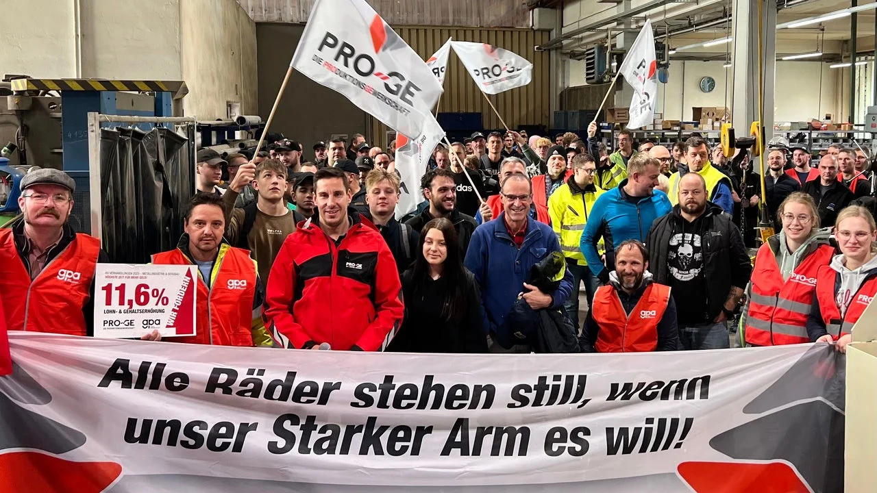
High participation in strikes, blockades
Workers in the metal industry are willing to continue the fight for a decent wage increase. It is now up to the employers to come up at last with a new offer that is in line with an average inflation rate of 9,6 percent over the last 12 months and is therefore negotiable for us. This is the only way to prevent an indefinite strike. In any case, we are ready for serious negotiations to reach a deal with the employers on Thursday 9th November, even if we will have to continue till the small hours, says PRO-GE chief negotiator Reinhold Binder.
The fifth round of negotiations starts on November 9th at 11 am. The demand for a 11.6 percent pay rise for 200,000 workers in the metal industry is still unchanged.
The new collective agreement should have been in force since November 1st.

Slide 18
Employment of foreigners in Austria (09/23)
 | Origin | Number
1 | Total figure | 1.000.840
2 | Europe | 875.313
3 | Asia | 86.584
4 | Africa | 19.251
5 | America | 12.957
6 | Australia and Oceania | 799
7 | Unknown nationality | 5.936

Slide 19
Foreign workers from Asia and Africa (09/23)
Asia | 86.600
Afghanistan | 19.300
Iran | 8.000
India | 7.000
Irak | 4.700
China | 5.900
Philippinen | 4.800
Africa | 19.250
Egypt | 3.700
Nigeria | 3.500
Somalia | 3.000
Tunisia | 1.500
Maroc | 1.000

Slide 20
Access to the Austrian labour market for non EU countries´nationals
Binding job offer
The basic prerequisite for the majority of residence permits is a binding job offer with position in the collective bargaining agreement ("Einstufung in den Kollektivvertrag") your company pertains to.
Residence and work permit
All third-country nationals need a residence permit in order to live and work in Austria for more than six months. Many residence permits are work permits at the same time. On the back of every residence permit card, there is an official note on if and where the third-country national is allowed to work.
Austria offers several different types of residence permits. The type of residence permit not only depends on why this person is in Austria but also on many other factors, such as: Nationality, Family status, pay, income situation, planned duration of stay, qualification and age;
It is prohibited to employ third-country national who do not have a valid residence permit! Exception: spouses, close family members of EU/EEA/Swiss citizens
Long-term employment under Austrian payroll
the most common residence permits for this purpose are the so-called Red-White-Red Card as well as the Blue Card. Those permits are issued for up to two years and can then be extended, paving the way for your employee to stay and work in Austria for a long period of time. In those first two years, your employee is bound to you and cannot simply work for a different company.
A labour market test ("Ersatzkraftverfahren") is conducted by the Austrian Public Employment Service AMS as a part of processing certain residence permit applications. It implies that AMS verifies that no member of the Austrian labour market could fill your vacancy. However, several residence and work permits are processed without a labour market test.

Slide 21
Recruitment and need of skilled labour
Sharp rise in Red- white-red cards that were issued
  6.200 in 2022 (in 2021 3.881)
  1.900 in first Half year of 2023
  Basis: Fachkräfteverordnung 2022 (Decree on labour market access ) and permanent seasonal workers- adaptation to ease access (point system or minimum salary requirements eliminated)
Economic chamber of economy: need for more than 10.000; target countries- Indonesia, Philippines, Brazil, Kosovo, Albania, Northern Macedonia;

Slide 22
Access to the Austrian labour market for non EU-nationals
Ukrainian refugees
In theory : Unlimited Access for ukrainian refugees, but limited residence- simplified permit procedure for employment, as soon as they can procure a so-called Blue card (ID for displaced persons).
In late January 2023, the temporary right of residence was extended to 4 March 2024.
In practice some 80.000 Ukrainian refugees –mostly women with children- experience precarious living conditions (more than 50% not employed, but covered by basic asylum seekers benefit with limits on additional income they are allowed to earn)

Slide 23
Demands from PRO-GE (ÖGB)
Prevention of wage and social dumping for all workers no matter where their destination is
Successful integration in the labour market requires support and advice (involving communities in host countries).
Determination of skills and qualifications already acquired – this involves cost-free recognition of qualifications in their home countries.
Language courses are key to help them to integrate in their host country
Employers that demand to employ third countries´workers should be more involved in financing information and consultation centres and training
In addition, there is a shortage occupation list for employees from third countries - moving away from the existing calculation system towards a new competency-oriented system for assessing the required qualifications. In addition, differentiated or more precise assessments should be used to determine whether the economy is actively making provision for the need for skilled workers- apprenticeships, continuous training and requalification offered to workers/employees.
We rather talk about need for skilled workers instead of shortage of workers- instead of recruiting cheap labor potential recruitees have to be activated (women- training, care facilities; elder workers)
Clear definition in the „Red-White-Red Card“ (RWR-Karte) that skilled workers have at least completed vocational training;
Newly recruited workers/employees should not be bound to the employer for two year;
  At European level:
  Legislation- Proposal for a Directive on third country nationals and their rights – ETUC and IndustriAll Europe should deal with; as well as forced labour legislation ;
  What is going on with European Labour Authority ?

Slide 24
Automotive industry
Austria- remarkable comeback of supplier industry
  Five big companies gained a turnover of more than 15 billion Euro (ZKW grew by 20 %)
  Automotive supplier industry employs over 90.000 workers/employees (over 3000 more than 2021)
    All have sites in our Memorandum Group- interaction and cooperation (including EWCI should be increased for organizing and more transparency;all in E-Production
      Magna Steyr- Slovakia, Czech Republic, Germany, Austria- 2024 Production of E-Class Mercedes Benz
      BMW Steyr- Hungary, Germany, Austria
      Pierer Mobility (KTM)-software- test system, hydrogen and fuel cell technology
      Robert Bosch- investments in semiconductor production (Germany, Malaysia)
      Stellantis- closure of site in Vienna Aspern (350 workers)

Slide 25
List of 20 largest automotive suppliers:
Magna Steyr: Umsatz 4,8 Mrd. Euro, -4,7%
BMW Österreich: Umsatz 3,6 Mrd. Euro, +8,7%
Pierer Industrie: Umsatz 3,3 Mrd. Euro, +19,6%
AVL List: Umsatz 1,9 Mrd. Euro, +18,0%
Bosch Österreich: Umsatz 1,4 Mrd. Euro, +1,0%
ZKW Group: Umsatz 1,4 Mrd. Euro, +27,1%
Kromberg & Schubert: Umsatz 1,3 Mrd. Euro, +22%
BRP-Rotax: Umsatz 1,3 Mrd. Euro, +27,9%
Miba: Umsatz 1,1 Mrd. Euro, +14,7%
Rosenbauer: Umsatz 972,2 Mio. Euro, -0,3%
Steyr Automotive: Umsatz 780,0 Mio. Euro, -0,25%
Rheinmetall Österreich (MAN Vehicles): 697,8 Mio. Euro, +14,4%
Gebauer & Griller: Umsatz 603,0 Mio. Euro, +8,8%

Slide 26
List of largest automotive suppliers 2022:
14.Polytec: Umsatz 601,4 Mio. Euro, +8,2%
15.Knorr-Bremse: Umsatz 553,0 Mio. Euro, -0,5%
16.Hirschmann Automotive: Umsatz 530,5 Mio. Euro, +15,3%
17.Wilhelm Schwarzmüller: Umsatz 466,0 Mio. Euro, +13,9%
18.Mahle: Umsatz 435,0 Mio. Euro, +2,3%
19.Pankl Racing Systems: Umsatz 369,3 Mio. Euro, +29,5%
20.Banner: Umsatz 307,0 Mio. Euro, +7,3%

