Slide 1
Automotive Industry in Czech Republic
Vienna Memorandum Preparatory Group Meeting,
7.11.2023

Slide 2
Characteristics of the industry
In the first nine months of this year, a total of 1,017,933 passenger vehicles were produced in the Czech Republic. This represents year-on-year growth of 11.5%. Despite the lower production results in September itself, which caused breakdowns in the supply of parts at the Cologne-based Toyota and Škoda Auto in Kvasiny, the threshold of one million manufactured vehicles was conquered a month earlier this year. The share of vehicles with electric drive is also growing, which currently represents 13,2 % of the total production of motor vehicles. A total of 97,992 purely electric and 36,332 passenger vehicles with plug-in hybrid drive.

Slide 3
Economic development of the industry
Development of main economic indicators in Czech Automotive Industry
Source: ČSÚ, OS KOVO own calculations

Slide 4
Companies in sector

Slide 5
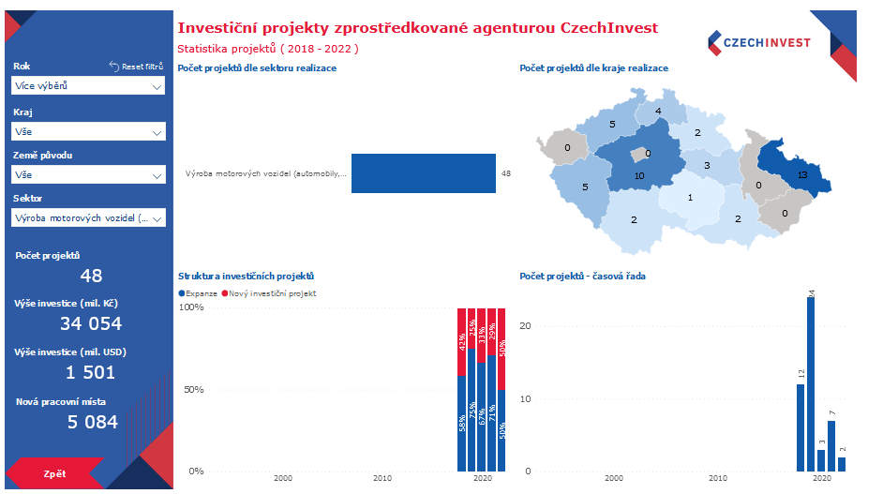
Investments I.
Between 2018 and 2022, the Czechinvest agency mediated 48 investment projects with an invested amount of CZK 34,054 million (EUR 1,384 million).
5,084 new jobs were created.
Most of the investments were made in the Central Bohemian and Moravian-Silesian regions.
The largest number of new jobs were created in Central Bohemia (1,696 jobs).
Most jobs (1,508 jobs) were created thanks to Japanese investments.

Slide 6
Investments II.
Investments according to country of origin:

Slide 7
Problems of the sector
Problems of the Czech Automotive Industry:
72% of sales in the Czech Republic are corporate customers
All headquarters and development centres are outside the Czech Republic, decisions are made abroad about what and where will be produced, so the impact on a fair transition is minimal
Concerns about the possible transfer of production to the mother countries - robots will be equally expensive everywhere
Inadequate system of retraining, outdated education, which is no longer sufficient for market requirements → the expertise of employees is decreasing, including those newly entering the labour market
Extremely high input energy prices thanks to the policy of the Czech government
Missing materials or components
Low wages and a high number of foreign employees (agency employment) from countries outside the EU
The Czech customer is not ready for electro mobility (high price)
Global competition – manufacturers outside the EU still produce internal combustion engines, they finance the development of new technologies from their profits, Europe will not be economically able to continue in the set direction

Slide 8
Health and Safety I.
Health and Safety
Digitalisation in the automotive industry has an impact on working conditions, the introduction of new technologies changes dangers and risks
New challenges are emerging in the field of health and safety, especially of an ergonomic, organizational and psychosocial nature
Musculoskeletal disorders - causes:
Repetitive hand or arm movements
Long sitting
Lifting and moving heavy loads
Psychosocial risks - causes
Use of work pace systems
Workplace monitoring (employee performance tracking)
Lack of human communication (robotic workplaces)
Isolation (remote work)

Slide 9
Health and Safety II.
Examples from practice
Initially, there were great discussions about whether employees on the production lines must be specially trained in the assembly of hybrids and EV cars, but in the end, practice has shown that this is not necessary, with a few exceptions.
But what has turned out to be a potential problem is the ignition of electric cars from the batteries. It also happens that they catch these batteries in warehouses, that's why manufacturers of batteries for electric cars have trained firefighters, and they also have containers of water where these burning vehicles are closed, not extinguished. The reason for the ignition is often cheap parts for a few cents, which can be found even at the manufacturers of prestigious premium brands.

Slide 10
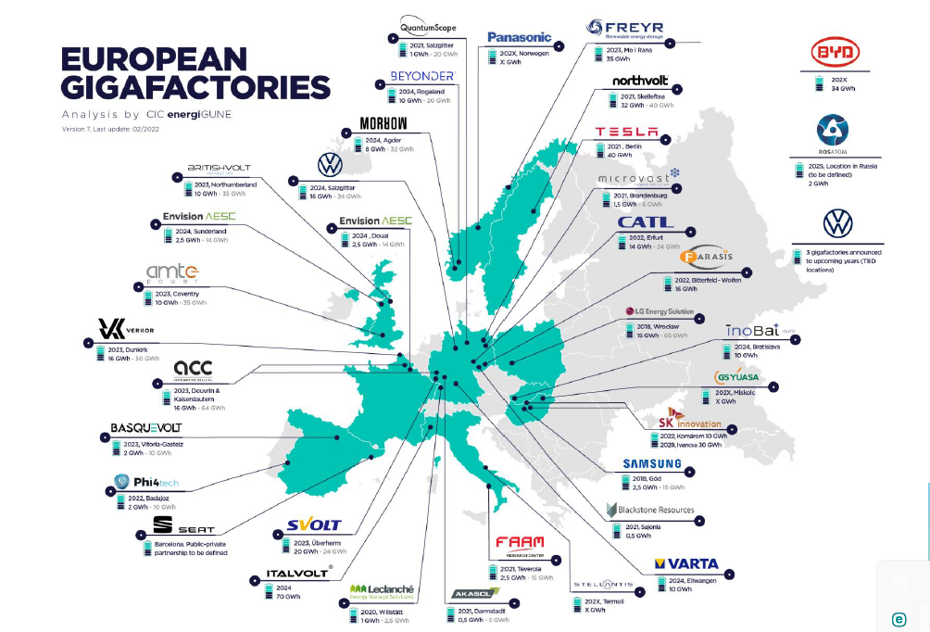
Automotive Future
Production of batteries
In the Czech Republic, there are stocks of key stocks of materials needed for the production of lithium battery cells (lithium, manganese, cobalt, ...). The problem is that mining is very non-ecological, high costs have to be incurred for its greening, so mining becomes significantly more expensive, and of course these high costs are ultimately paid for by the end customer.
VW has not yet decided on the construction of a gigafactory for the production of batteries in Europe, the Czech Republic (Líně near Pilsen), Slovakia, Hungary and Poland are in the game - indications are that Poland will be the winner.

Slide 11
Automotive Future
In the Czech Republic, the Czech Battery Cluster was established in 2022, the aim of which is to ensure a partnership between the private and public sectors, supporting the cooperation of private companies, the research sphere and the public sector.
Cluster visions
Effective cooperation of scientific research institutions, private and public sector
Technical education for the 21st century in close cooperation with the private sector
Creation of new know-how linked to individual parts of the value chain
Active participation in European and international projects and consortia
Attracting foreign direct investment in batteries
Retraining of existing employees
Attracting and developing talent
Planned activities
Support and development of SMEs
Cooperation between academia and SMEs on joint projects
Access to funding sources
Technical conferences and networking events
Facilitation of outsourcing and branding
Internationalization of members
Human resource development and talent attraction services
Feedback for public administration

Slide 12
Automotive Future
Chip manufacturing
Unfortunately, the investment by the Taiwanese company TSMC was won by Dresden, Germany
The multinational chip manufacturer Onsemi in Rožnov pod Radhoštěm is investing 7.5 billion crowns in the expansion of production this year alone. Last year it was almost four billion.
The Czech Republic is one of the three places under consideration, where this important semiconductor producer would like to invest even more money in the future. But the United States and South Korea are also in the game. What kind of incentives these countries come up with will be important in the decision.
The decision in which of the three locations in the world Onsemi will massively invest in the expansion of chip production has not yet been made. According to Aleš Cáb, the production director of the Rožnov company, a decision should be made by the end of February next year.

Slide 13
Automotive Future
National Semiconductor Strategy
HN 13.10.2023
The Czech Republic is following up on the European Chip Act by preparing a National Semiconductor Strategy. "It will map the types of chips in which the Czech industry has the greatest potential, and propose what support measures, including investments, to implement. And above all, it will help us set up the education system correctly, because the development of this industry cannot be done without enough qualified workers," Minister Síkela explained in the summer. At the time, his ministry announced that it would complete the strategy in cooperation with experts in the first half of next year. But now it looks like he'll be a little faster at it.
Preparations are designed to finalize the strategy by the end of this year," David Hluštík from the press department of the Ministry of Industry and Trade told HN. Ministries collaborate on the strategy with associations that bring together representatives of the semiconductor chain.

Slide 14
Automotive Future
Use of hydrogen
National Hydrogen Strategy (2021) - being updated as it is out of date
It is assumed that domestically produced hydrogen cars will not be produced for the Czech market, at least in the initial stages. In the short term, however, there is already the possibility of cooperation and involvement in the creation of entire passenger cars and targeting foreign markets.
WEAKNESSES
Competition from abroad already has a considerable lead
Large foreign manufacturers may aim to produce on their own territory
Lower purchasing power of residents in the Czech Republic compared to DE, AT
Dependence on subcontracting
The largest Czech car manufacturer's declared support for electromobility
Current barriers to the development of hydrogen technologies in the Czech Republic
Legislative-regulatory barriers (absence of laws, safety regulations, certifications, standards, lack of laboratory capacity for experimental activities)
Technical-economic barriers (geographic-climatic conditions, limited readiness for distribution, storage and transportation)
Rather, trucks and buses are being considered, projects for the production of green hydrogen exists

Slide 15
Automotive Future
Synthetic fuels
Production in the Czech Republic is still unimaginable, according to docent Pavel Šimáček, a fuel expert from the Technical University of Applied Sciences. He claims that the energy requirements of the production of synthetic fuels are enormous, while in the Czech Republic we do not even have any production capacity.
The price is up to five times that of conventional fuels - an optimistic estimate that it will decrease to four times by 2050)

Slide 16
OS KOVO Priorities
Trade Union Priorities
Sustainable and reasonable energy prices
Support for investment in the future of the automotive industry
Construction of a high-quality education system, including a functional system of lifelong education
No more cheap work
Maintaining quality jobs, moving employees quickly between jobs, leaving no one without help

