Slide 1
Wiener Memorandum Expert meeting in Györ 6.11. – 8.11.2023
Mateja Gerečnik

Slide 2
One in seven persons in employment is a foreign citizen
Key statistics:
0.2% more persons in employment on a monthly basis;
1.3% more persons in employment in construction compared to January;
14.1% of the persons in employment (excluding farmers) are foreign citizens.
The number of persons in employment increased in most activities compared with January, except in manufacturing, wholesale and retail trade, repair of motor vehicles and motorcycles, real estate activities, and electricity, gas, steam and air conditioning supply. The largest increase was recorded in construction, up by 1.3% (or just under 1,000 persons, to around 74,700). This is almost half of the monthly increase in the number of persons in employment. At the annual level, the number of persons in employment in construction went up by 6.1%.
At the monthly level, the largest decrease in the number of persons in employment was recorded in manufacturing, down by 0.1% (by around 140 persons, to approximately 211,500). Compared to the previous February, the number of persons in employment in manufacturing went up by 1.1%.

Slide 3
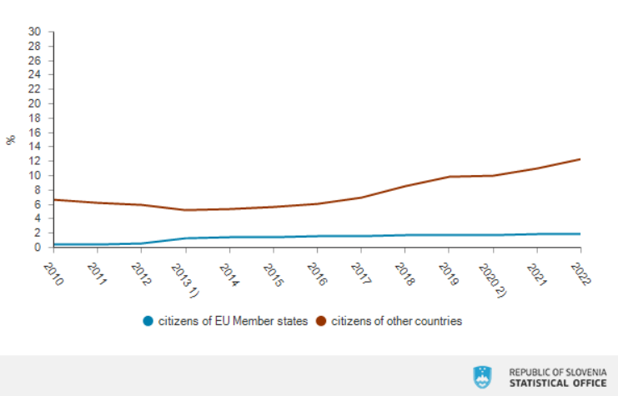
Share of foreign citizens in total persons in employment, Slovenia

Slide 4
Changing the law to speed up the recruitment of foreigners, april 2023
The amendments to the Employment, Self-employment and Work of Foreigners Act are aimed at simplifying procedures, though this does not mean less legal protection for foreign workers. The aim of the Ministry of Labour is not only to ensure that there are enough workers, but also to ensure adequate working conditions and fair pay.
With the amendment coming into force, a foreigner, during the validity period of a single permit, will be allowed to change employers and jobs, or to be employed by several employers, solely on the basis of the consent of the Employment Service of Slovenia (ESS), i.e. without the need for an administrative unit ruling.
Foreigner nationals who are employed in the public sector will not be subject to the provisions of the amended law. There is a serious shortage of suitable staff in the public sector, especially in the health and social services sectors (health centres, homes for the elderly, day-care centres and social security training institutions, public institutions providing social services such as family care in the home, and public social security institutions that provide social welfare services). The procedures at the ESS are complex because of the need to determine the education, language skills and qualifications of foreign nationals. Therefore, the amendment does not apply to foreign nationals who will be employed in the public sector, which means that the ESS will not grant consent for employment in the public sector.
Asylum seekers who have the right to access the labour market under international protection laws will be able to exercise their right to free access to the Slovenian labour market after having had asylum seeker status for three months. The Law on Employment, Self-employment and Work of Foreigners currently states that they have free access to the labour market after nine months of asylum seeker status.
A new time limit has been introduced for entry into employment when a foreign national, during the validity of a single permit, changes employer or is employed by two or more employers on the basis of a new consent from the ESS, i.e. without the written approval of the administrative unit.

Slide 5
Automotive industry in Slovenia
The August floods caused enormous economic damage in Slovenia. According to government estimates, this reached EUR 5 billion, which corresponds to almost 9% of GDP.
Due to the floods and the resulting shortage of car parts produced in Slovenia, the Volkswagen factory in Portugal and the Škoda factory in the Czech Republic were forced to stop production, EIU writes.
The production shutdowns, which are expected to continue at least until the end of November, are already causing disruptions further down the supply chain, and the EIU predicts that disruptions to European automotive supply chains will continue well into the future.
In its report, the EIU states that the automotive industry is an important part of the Slovenian economy, as it represents 20% of total exports and 10% of GDP, and at the same time it is closely integrated into European supply chains. Every car produced in Europe has at least one component from Slovenia. As a result, the damage caused by the August floods to Slovenia's automotive industry will have a major impact not only on the Slovenian economy, but more broadly on the European automotive sector.

Slide 6
Predictions for 2024
EIU data on Slovenian industrial production for the period January–July 2023 indicate a -4.2% annual decline due to sluggish external demand from export markets such as Germany. The impact of floods will have an additional negative impact on year-round industrial production.
The EIU therefore predicts slower economic growth and a larger fiscal deficit for Slovenia in 2023, and stronger growth again in 2024, as reconstruction efforts will stimulate investments in the coming year.
Automotive supply chains across Europe will be further disrupted in the short term, according to EIU forecasts.
Analysts at Fitch Solutions in Slovenia predict a slowdown in GDP growth from 5.4% in 2022 to 1.1% in 2023, as floods will reduce private consumption in the last two quarters of 2023. The outlook for 2024 is slightly more optimistic as recovery efforts are likely to increase gross fixed capital formation. Fitch forecasts 2.9% GDP growth for Slovenia in 2024.

Slide 7
Car production in Slovenia by year
Volkswagen has the largest market share in car sales in Slovenia. This amounted to 15.9% in 2022. It is followed by Škoda with a 9.9% market share, and third is Renault with an 8.7% market share. Last year, Hyundai and Toyota had 6.9% and 6.4% market share respectively, while Kia and Peugeot had 6.2% and 5.4% market share respectively. Citroen follows with 4.6%, and Dacia and Opel each with 4.1%. A wide variety of other brands account for the remaining 27.7% market share.
In recent years, the electric car market in Slovenia has also recorded great growth. Battery electric vehicles (BEVs) now have a 10.7% market share, closely followed by hybrid electric vehicles (HEVs) with a 9.6% market share.

Slide 8
Some general data
Average monthly gross earnings August 2023 – 2221,85 €
Average monthly gross earnings for year – 2023,92 €
Labour cost index (same quarter of previous year = 100) – 114,6
Minimum wage – 1203,36 €
Inflation – annual inflation rate – 6,9 %
Inflation – monthly inflation rate October 2023 – 0,2 %

Slide 9
Collective bargaining and TU activities
Increase in basic salaries by 8 % to 15 %
Amendment to the Labor Relations Act (TU success)
An additional five days of unpaid leave in the case of caring for a family member or a person with whom the employee lives in the same household who needs more extensive care and support for health reasons.
The non-discriminatory subsidiary liability of the contractor for non-payment of wages to the employee is regulated, namely in the context of the provision of a service in the context of subcontracting, which until now was limited only to foreign employers who perform work with workers in the context of cross-border provision of services.
The wage compensation for agency workers at companies is increased, thereby increasing the social security of workers during periods of unemployment. During the time when the agency does not guarantee the work of workers at the user, instead of at least 70 percent of the minimum wage, the workers will be entitled to 80 percent of the worker's wage, as is the case for compensation of the wages of the remaining workers in the case of waiting for work.
The right to disconnection is introduced, which gives the employee the right that the employer does not interfere with his free time during a daily or weekly rest period, the use of annual leave or other justified absence from work.
Employee representatives and trade union trustees will now be guaranteed effective legal security. Amendment ZDR-1 legislates the suspension of the effect of the dismissal until the decision of the labor courts at the first instance, i.e. a maximum of 6 months for labor representatives and their higher compensation due to the prohibition to perform work (instead of 50 percent they will be entitled to 80 percent of the salary) and legal protection against a written warning from resignation.

